Slide 1
Leveraging Generative Models
for Real-Time Chess Commentary
Team 34
Aarya Devnani
Arjun Balamwar
Kavish Shah
Nimit Jhunjhunwala
Prisha Panchmia

Slide 2
Motivation
Address limitations in current systems, such as inability to capture complex strategic nuances and long-term game progression.
Enhance chess commentary systems by integrating generative models for real-time, context-aware analysis.
A human commentator may introduce variations in the aspects they choose to talk about. Variation in commentary helps avoid monotony, making such a game and dataset ideal for testing natural language generation (NLG) and pragmatic language modeling.

Slide 3
Research Questions
What role do knowledge graphs and historical data play in enriching chess commentary?
What role does retrieval-augmented generation (RAG) play in generating insightful commentary?
Can large language models produce commentary comparable to human experts in terms of quality and depth?
How effective are large language models compared to traditional rule-based and neural systems in chess commentary?

Slide 4
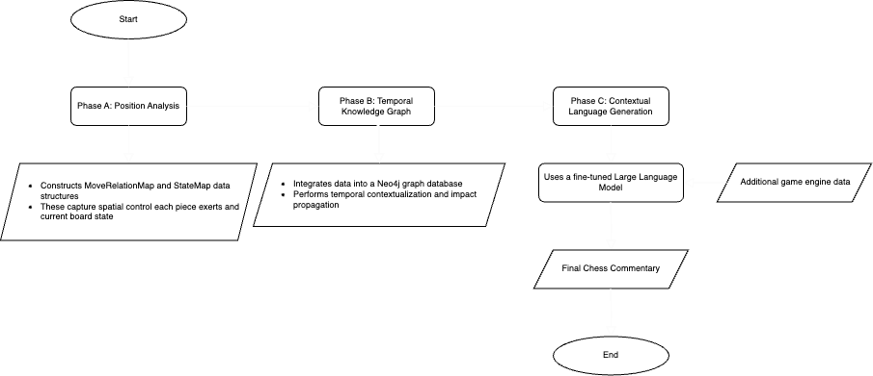
Flowchart of Methodology

Slide 5
Methodology
Phase A: Position Analysis and constructing two primary data structures
MoveRelationMap:
Maps positional influence data (attacking and protecting pieces).
Keys: Chess board positions.
Values: Pieces exerting control (friendly and opponent).
StateMap:
Captures current positional occupancy.
Keys: Board positions.
Values: Pieces occupying these positions.
Establish a detailed snapshot of the board’s state for baseline analysis.

Slide 6
Methodology
Phase B: Build Temporal Knowledge Graph
Nodes: Chess pieces.
Edges: Interactions (attack, protect, check, checkmate).
Capabilities of the Knowledge Graph:
Temporal Contextualization:
Represents board states over time.
Impact Propagation:
BFS traversal for cascading influences of positional changes.
Tracks both direct and indirect piece interactions.
Integrate historical and current game states for richer analysis.

Slide 7
Methodology
Phase C: Contextual Language Generation
Input Sources:
Insights from Phase A and Phase B.
Additional engine data (piece values, evaluation scores).
Generate Commentary:
Large Language Model (LLM) on chess-specific data.
Produce human-like commentary focusing on:
Tactical and strategic relevance.
Immediate move implications.
Broader game progression context.

Slide 8
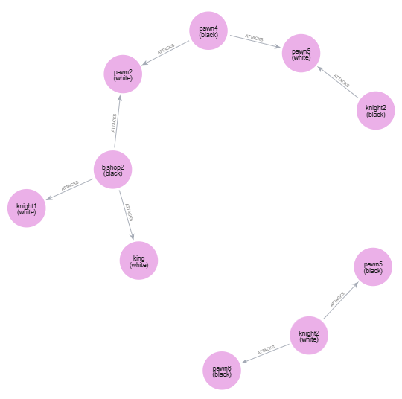
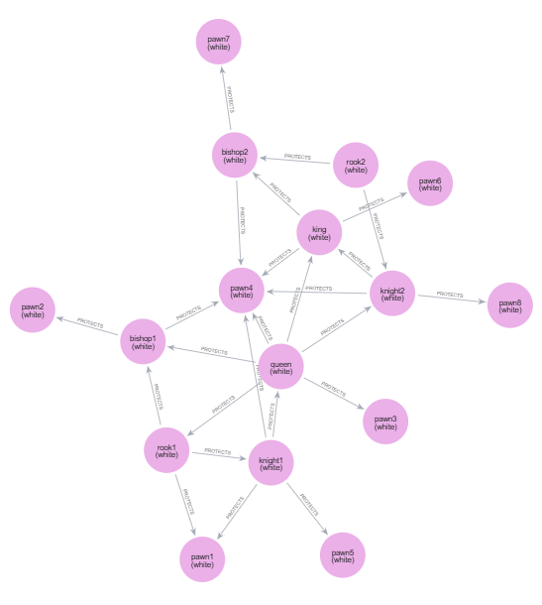
Results
Snapshots of the knowledge graph for attack (left) and protect (right) configurations

Slide 9
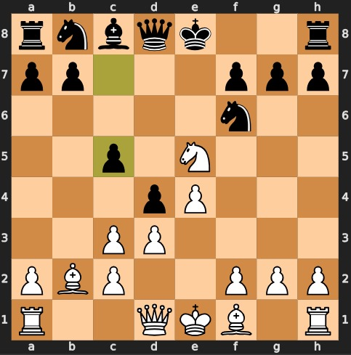
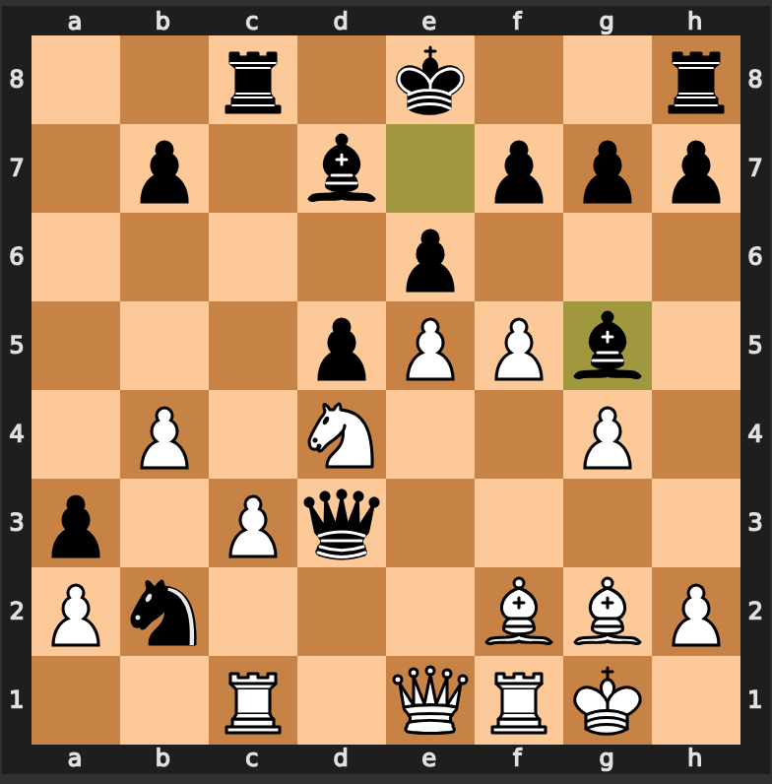
Results
With the last move, c7c5, Black has opened up the center and gained much-needed space. The game has been a tense battle for central control, with both players competing for the critical e5 square. White has established a strong knight on e5, but Black has responded by advancing their pawn to d4, creating a solid pawn center and exerting pressure on White’s position.
Black's bishop boldly strikes at g5, threatening the white rook and exposing the queen to danger. A tactical battle looms, with both sides' pieces poised to strike.

Slide 10
Questions?

